Slide 1
We Are The Future
Team 8
Ismael Al Sabea, Jorge Gonzalez, Po-Yu Liu, Zachary Tarell, and Saffi Zaidi
Weekly meetings: Wednesdays at 4:00 pm on campus

Slide 2
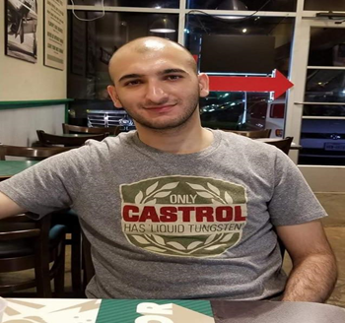

Name
Po-Yu Liu
Major
Software Engineering
Classification
Junior
Key technical skills
Java, C++, C#, SQL, Python
Jobs after graduation
Software Developer
Name
Ismael Al-Sabea
Major
Software Engineering
Classification
Senior
Key technical skills
Java, C++, C#, SQL, Python, R, HTML, CSS
Jobs after graduation
Developer, Data Scientist, Architect

Slide 3
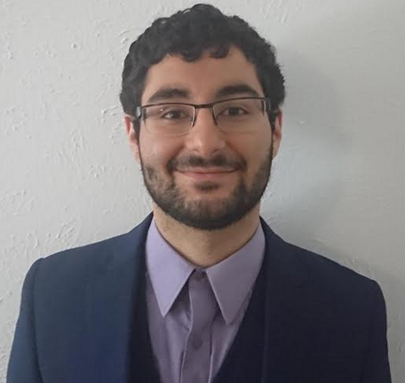
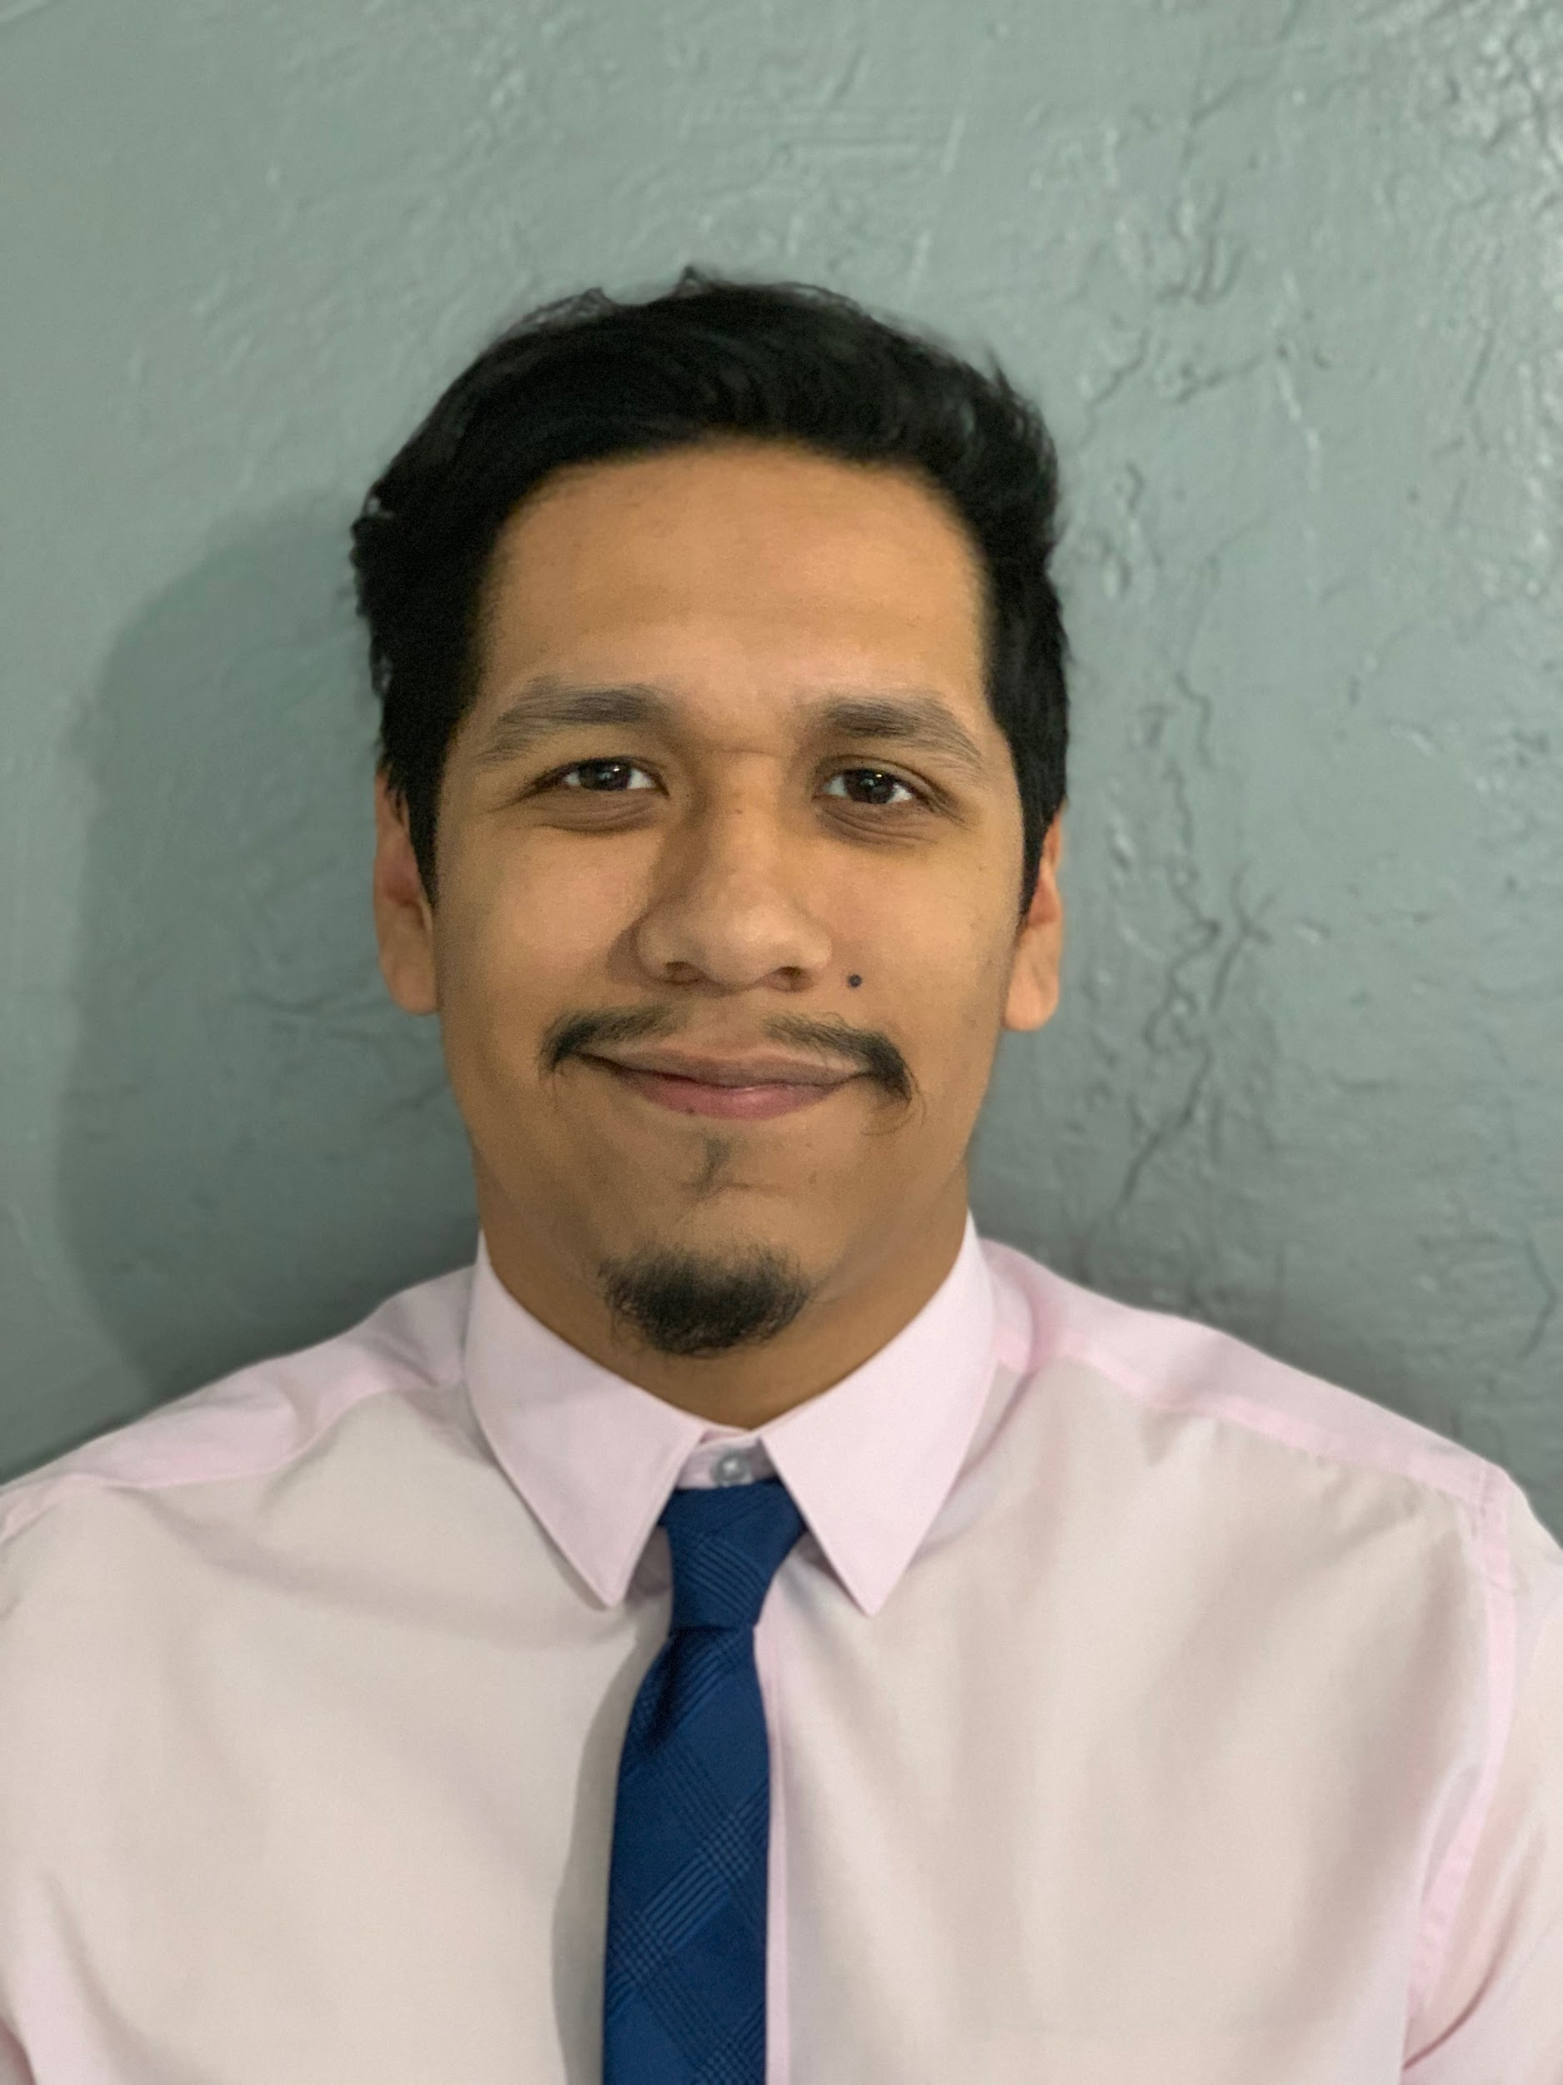

Name
Saffi Zaidi
Major
Software Engineering
Classification
Senior
Key technical skills
Java, C++, Python, SQL
Jobs after graduation
Java Software Developer
Name
Jorge Gonzalez
Major
Software Engineering
Classification
Senior
Key technical skills
Java, C++, SQL
Jobs after graduation
Java Software Developer, Backend Developer
Name
Zachary Tarell
Major
Software Engineering
Classification
Senior
Key technical skills
Java, C++, Python, R, SQL
Jobs after graduation
Software Manager, Backend Developer

Slide 4
SoW #1 - Fujitsu Circuit Resource Management (Our SOW)
Overview Of SoW:
Fujitsu Limited plans to enhance their current Managed Network Services capabilities so that they can provide enhanced functionalities to their customers along with better MTTR. Fujitsu is looking to enhance their operation with a new Circuit Resource Management (CrM) Solution. Ericsson will provide the Circuit Resource Management (CrM)
Overview Of Solution:
Create a CRM for Fujitsu
Customer:
Fujitsu
Why we chose it:
Interested to see how a Circuit Resource Management system is designed and planned

Slide 5
Project Overview
Fujitsu Limited plans to enhance their current Managed Network Services capabilities so that they can provide enhanced functionalities to their customers along with better Mean time to repair (MTTR). Fujitsu is looking to enhance their operation with a new Circuit Resource Management (CrM) Solution. Ericsson will provide the Circuit Resource Management (CrM). This solution will focus on Fujitsu’s need to manage their Network Operations Center (NOC) infrastructure and enable more efficient management of resources in the network.

Slide 6
Business Value
This project will provide a huge value for Fujitsu because of the saved time and money. The new system is designed to automate old tasks like keeping track of inventory, and even has features like auto-discovery of network topology. These system features will be aimed at reducing costs of the old inventory system as well as generating more income by automating tasks.
The Estimated Cost of the project will be 3,007,685.00 US Dollars

Slide 7
Interview Plan
The Interview Plan will consist of two Requirement Engineers and any other relevant stakeholders that will conduct an Interview Workshop. The Interview Workshop will include a summary and list of gathered requirements up until that point and will be presented to the relevant stakeholders.
We have 10 sections and are going to separate the interview process into 5 sections a week, totaling 2 weeks. The process will include the Core Team of stakeholders asking the majority of the questions as well as all of Fujitsu and Ericsson’s relevant resource operator’s necessary for that specific line of questioning.
The purpose of the Interview plan is to generate scenarios, improve current requirements by being more specific and avoid discrepancies. Questions will be generated based on the current requirements. These questions will help improve the conciseness and reduce ambiguity of the current requirements. Scenario-based questions and open-ended questions will be recorded and documented in order to trawl the requirements.

Slide 8
Sample Interview Questions
1) For the user interface, will you require a login interface for both the Admin client and User Client?
Yes, the first thing the users should see is a user login interface. The login interface should also have the capabilities of resetting their password and remembering their username.
2) What form of credential retrieval would work best when credentials are forgotten(i.e. Email, admin, etc.)?
Best form of credential retrieval will be through email. Backup information will be setup when creating the user profile.
Admin will also be able to reset user info if necessary, but as a last resort.
3) What should be the first thing the Inventory Admin/User see when entering the Program?
The user should be able to see the GUI inventory and the option to view Inventory database info with different graphical formats.
The user will have the ability to view different aspects of the inventory in detail as well as change graphical formats on a whim.

Slide 9
Sample Interview Questions(continued)
4) What should be the set time frames for the Sweep Modules when set to ‘periodically’?
The Sweep Modules can be scheduled to a variety of time frames; once a day, once a week, per month/etc.
The Sweep Modules can also be run manually whenever desired by the admin.
5) How many users are expected to be using the system?
The system will have an average of around 10,000 users concurrently.
Peak hours are in the average 15,000 users concurrently.
6) For the Inventory GUI Customization, will every action made by the admin gets logged?
Yes we would like to log every action made to the database and stored in a metadata folder
Actions made will be logged automatically instead of manually entered by the admin

Slide 10
Sample Interview Questions(continued)
7) Who is able to run the Sweep Modules when scheduled to run once or periodically?
The only users that have this access will be the administrators as well as the testing department for debugging purposes.
Each sweep should be logged and documented for any changes and stored in a metadata file
9) With the proposed system ability to view and customize map representations by the user, will these customized representations be able to be stored for future use?
Yes the maps created by the user will be able to be stored and saved.
Saved maps will be associated by the user profile and be retrieved when the user is logged in
27) Will users be able to customize their profiles to their preference?
Yes, users will be able to store preferred views, favorite equipment, etc.
13) In the event an admin’s or users account has been compromised, can other admins do anything?
Admins can terminate or freeze another admin or user’s account

Slide 11
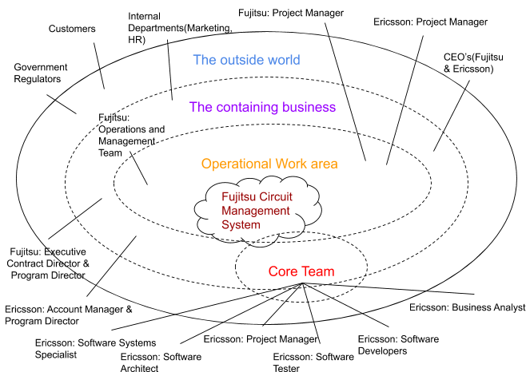
Stakeholder Map

Slide 12
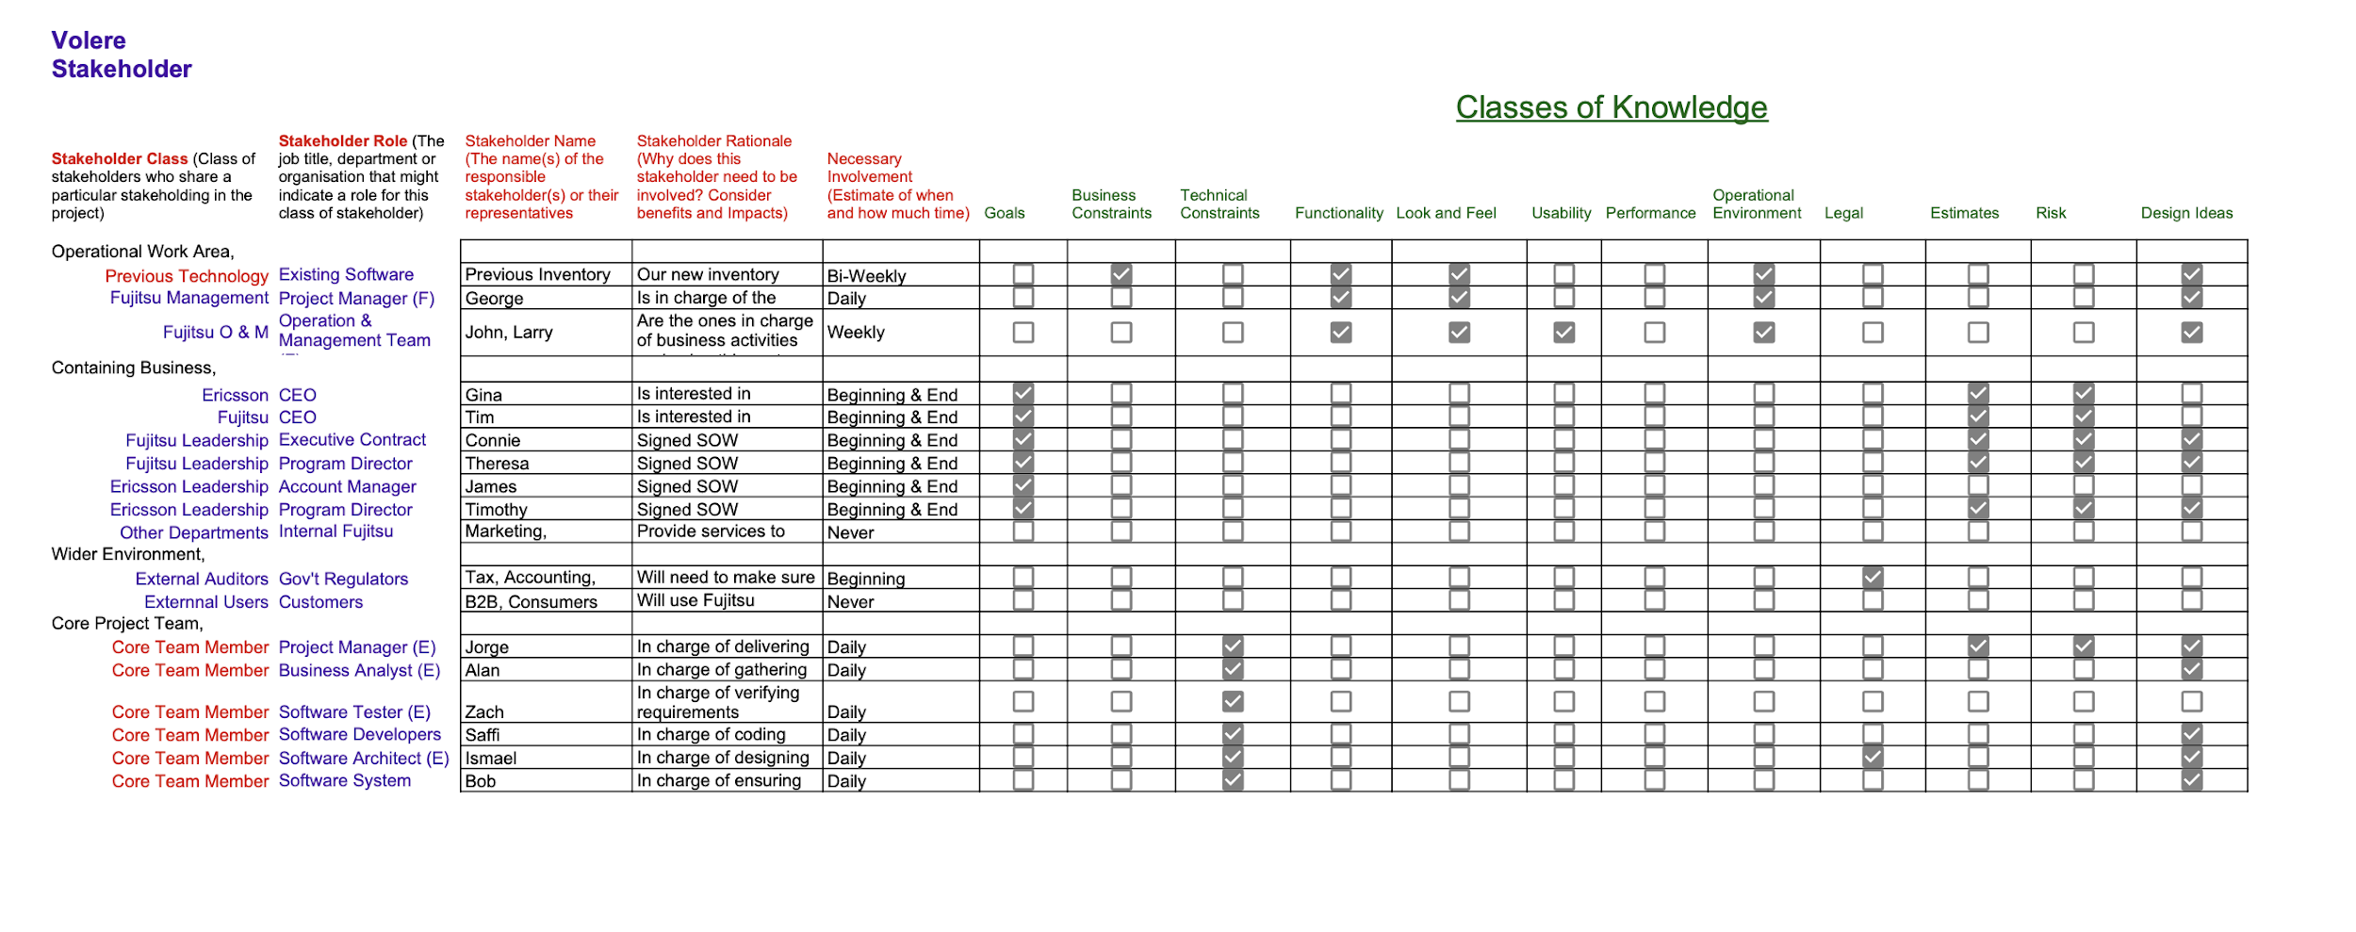
Stakeholder Analysis

Slide 13
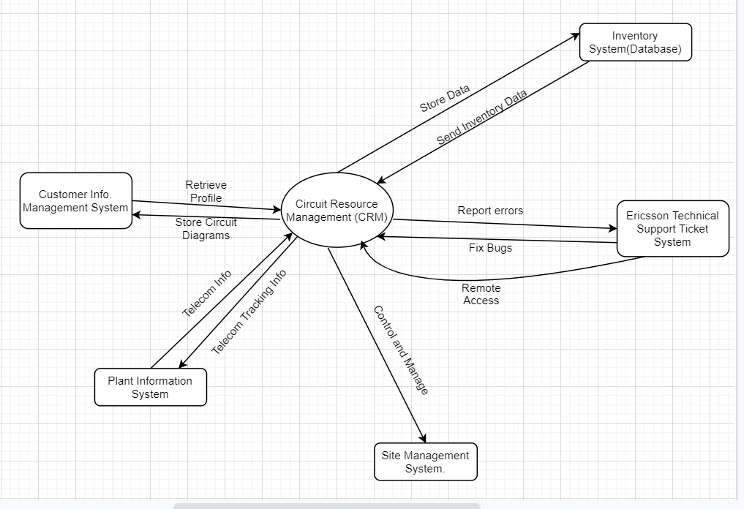
Context Diagram

Slide 14
Solution Constraints
Fujitsu’s Existing Software Architecture Inventory System must support Fujitsu’s current customers/users and expect order volumes and peak hours consideration.
The Inventory Core Database Server runs on Sun Solaris or HP-UX or Hp Itanium platforms.
The Ericsson Proposed Inventory Management Solution is composed of two Ericsson OSS Products; Ericsson Adaptive inventory (EAI) and Ericsson Discovery and Reconciliation. This software must be implemented and adapted into proposed solution Architecture.
The Inventory Management Solution database is required to run on an Oracle 11g RDBMS. The inventory database can also support Oracle RAC for WebLogic and Sun Configurations.
Ericsson must include current Fujitsu supported Inventory Database architectural design and data format.

Slide 15
Project Constraints
Financial - We allocated CDRM’s budget at 15% of $3,007,655. So, we cannot go over $450,000 for that specific expense.
Scope - Any change request or Milestone reached needs to go through proper channels. Following procedure 9.4 of the SoW stating that all will be reviewed and accepted accordingly following 3 main guidelines.
Quality & Resources - Ericsson must create the environments needed in order for test and production to begin in a timely manner. Installation services that Ericsson must provide are Installation planning, Environment verification planning, and On-site installation of the Ericsson licensed software on the hardware platform.
Risk - The Data Migration Assessment should be detailed and reviewed by Fujitsu and Ericsson completely as to avoid any potential loss of data between the installation of the new proposed solution.
Training/Maintenance - Fujitsu requires in contract that they will have to have 7x24x365 customer service so their training and maintenance of the new system must be followed by criteria in 6.2.1 and 7.6 of SoW, stating...
31 days prior the scheduled start of course is free of charge.
15-30 days prior the scheduled start of course is 50% off course fee.
0-14 days prior the scheduled start of course is 100% off course fee.

Slide 16
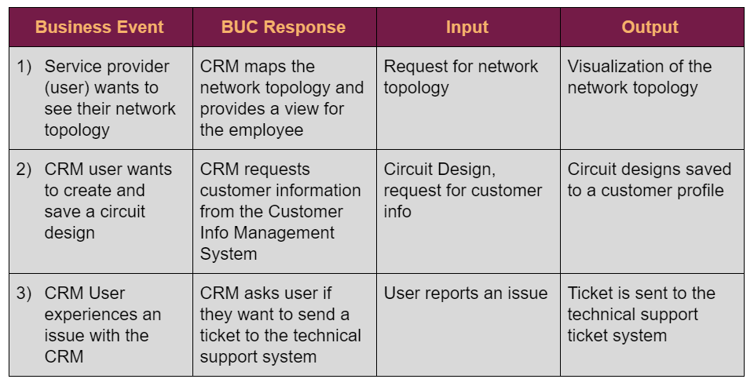
BUC List

Slide 17
BUC Scenarios
Event 1)
Business Event: Service Provider (End User) wants to see the network topology
Business Use Case Name: mapping and providing a topology of the network topology.
Trigger: Scheduled Network Review,
Preconditions: Scheduled Review.
Interested Stakeholders: Network Architect.
Active Stakeholders: Network Architect.
The Scenario:
The Network Architect wants to review the updated network topology
CRM conducts a mapping of the network topology and provides a visualization of it.
CRM provide this visualization to the Network Architect

Slide 18
BUC Scenarios
Event 2)
Business Event: Service Provider (End User) wants to save their circuit design
Business Use Case Name: Storing Design
Trigger: Customer clicks save design button
Preconditions: Design must be created
Interested Stakeholders: CRM customer
Active Stakeholders: CRM customer
The Scenario:
The customer finishes creating their design
The customer clicks on the save button.
The CRM calls the CIMS (Customer Information Management System) to retrieve the user profile.
The design is stored into the customer profile in the CIMS.
The user is presented with a system message stating that their design has been saved.

Slide 19
BUC Scenarios
Event 3)
Business Event: CRM Customer user calls technical support
Business Use Case Name: technical support fix the issue
Trigger: Customer experience an issue with the CRM system
Preconditions: N/A
Interested Stakeholders: the Customer.
Active Stakeholders: the Customer, the Technical support operator.
The Scenario:
While the Customer is using the CRM system, he encounters an issue with the system
Customer calls technical support and reports the issue.
Technical support fixes the issue either through telling the customer what to do to fix it himself, or through accessing the computer through remote access.

Slide 20
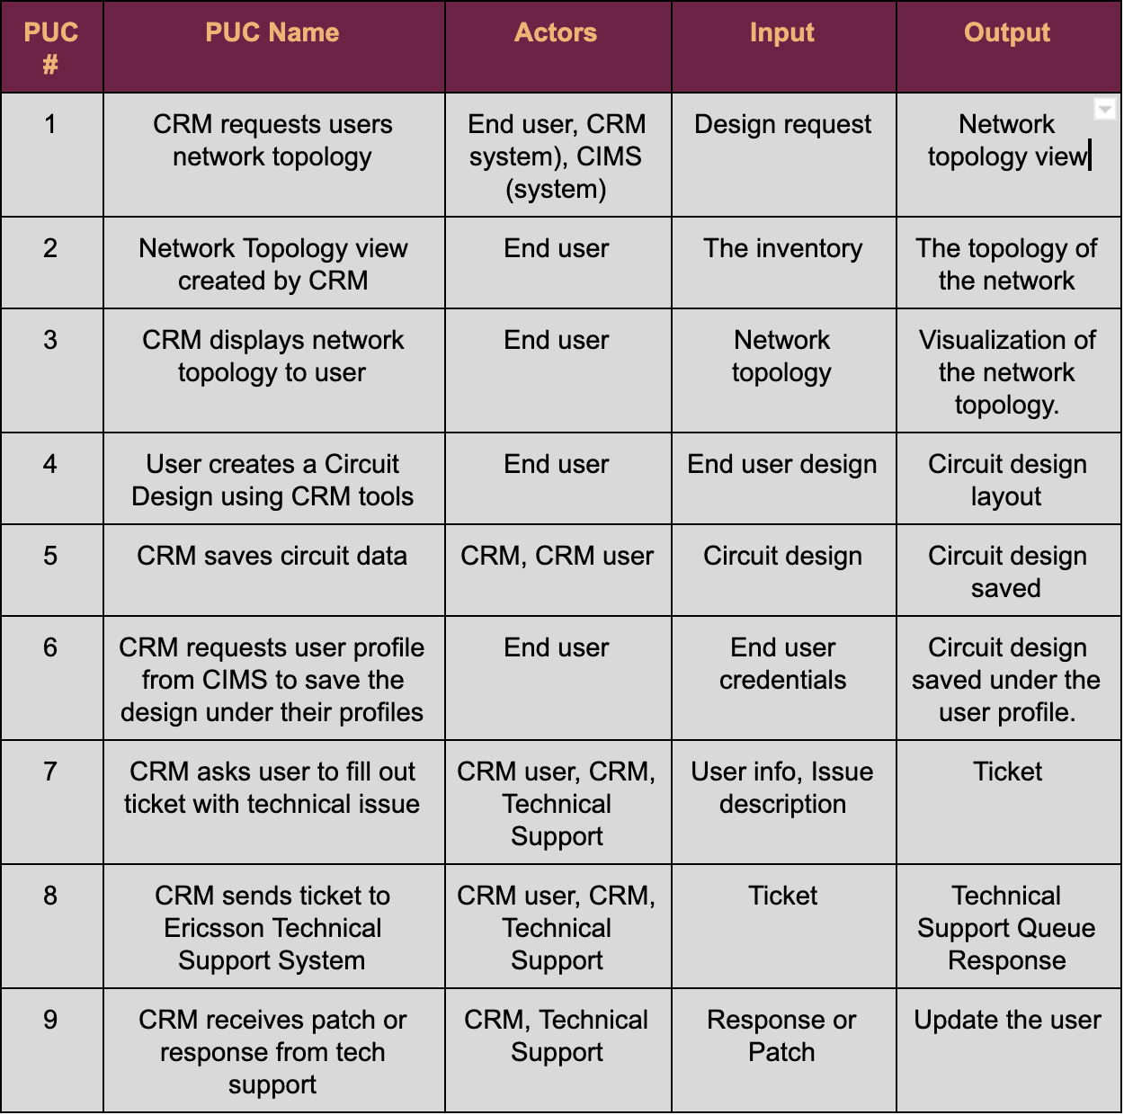
PUC List

Slide 21
PUC Scenarios
BUC #1) Service Provider (end user) wants to see their network topology
1. Product Use Case Name: CRM requests user network topology
Trigger: user requests their network topology
Preconditions: network topology is already stored
Interested Stakeholders: CRM user
Active Stakeholders: CRM user
Actor: CRM user
The product connects to the CIMS.
The product retrieves the user profile
The product requests for the design topology
Conclusion: The product ends up requesting the network topology stored from the user profile in the CIMS.
2. Product Use Case Name: Network topology view created by the CRM
3. Product Use Case Name: CRM displays network topology to user

Slide 22
PUC Scenarios Cont.
BUC #2) Service Provider (End User) wants to save their circuit design
4. Product Use Case Name: User creates a Circuit Design using CRM tools
Trigger: User wants to add a new circuit design to his profile
Preconditions: CRM user must have a login and profile
Interested Stakeholders: CRM user, CRM admin
Actor: CRM user
CRM user logs in
CRM user request to design a circuit.
CRM system opens a page where there are tools to design and create a circuit and the ability to import an already existing circuit design.
Outcome: CRM User finishes his design
5. Product Use Case Name: CRM saves circuit data.
6. Product Use Case Name: CRM requests user profile from CIMS to save the design

Slide 23
PUC Scenarios Cont.
BUC #3) CRM User experiences an issue with the CRM
7. Product Use Case Name: CRM asks user to fill out ticket with technical issue
Trigger: Issue is found in the system by user
Preconditions: user must already have access to the system
Interested Stakeholders: CRM user, Ericsson Technical Support system
Actor: CRM user
The product asks the user what is the issue
The product stores the issue into the log
The product sends the issue to Ericsson technical support
The product displays a message stating that the issue has been sent
Outcome: the passenger issue is recorded and sent to technical support to be reviewed.
8. Product Use Case Name: CRM sends ticket to Ericsson Technical Support Systems
9. Product Use Case Name: CRM receives patch or response from technical support system

Slide 24
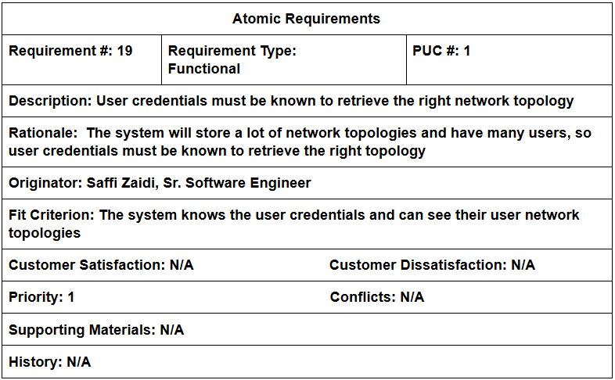
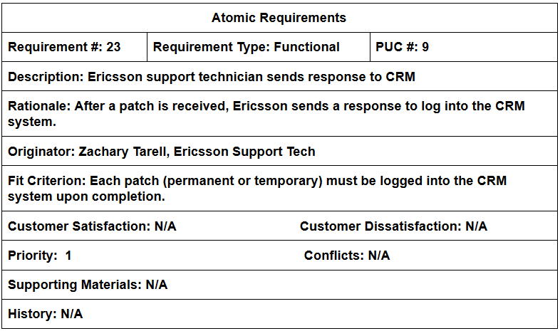
Atomic Requirements - Snow Cards (Functional)

Slide 25
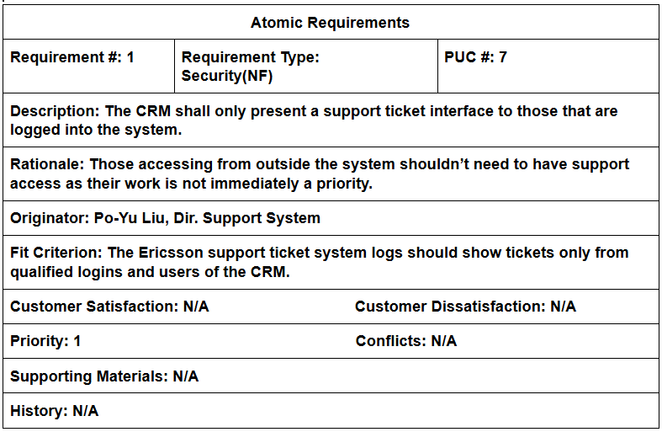
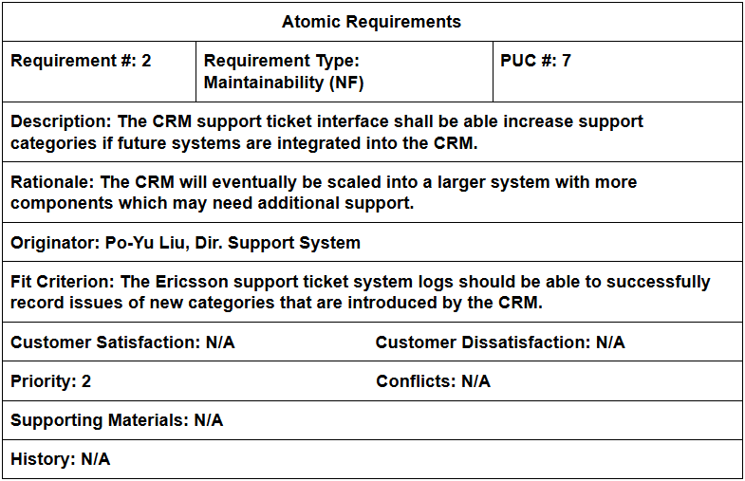
Atomic Requirements - Snow Cards (Nonfunctional)

Slide 26
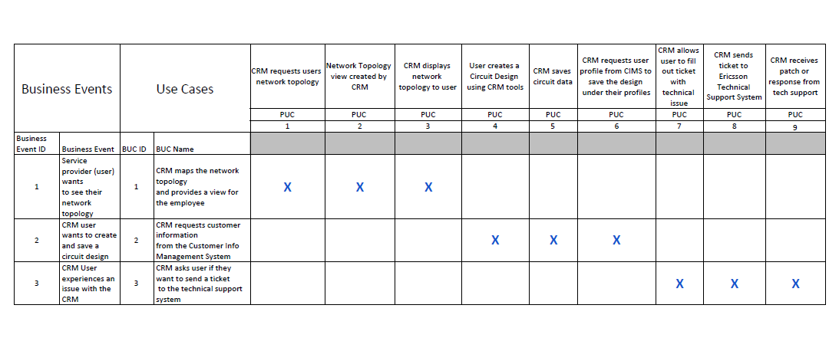
Traceability Matrix - BUC to PUC

Slide 27
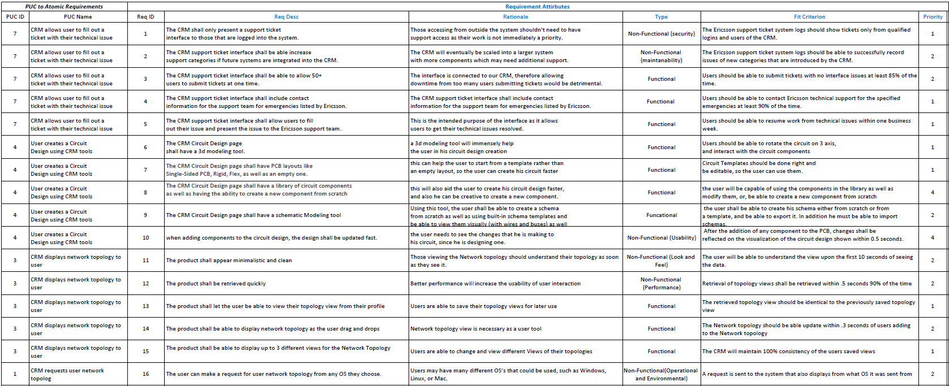
Traceability Matrix - Req to BUC/PUC

Slide 28
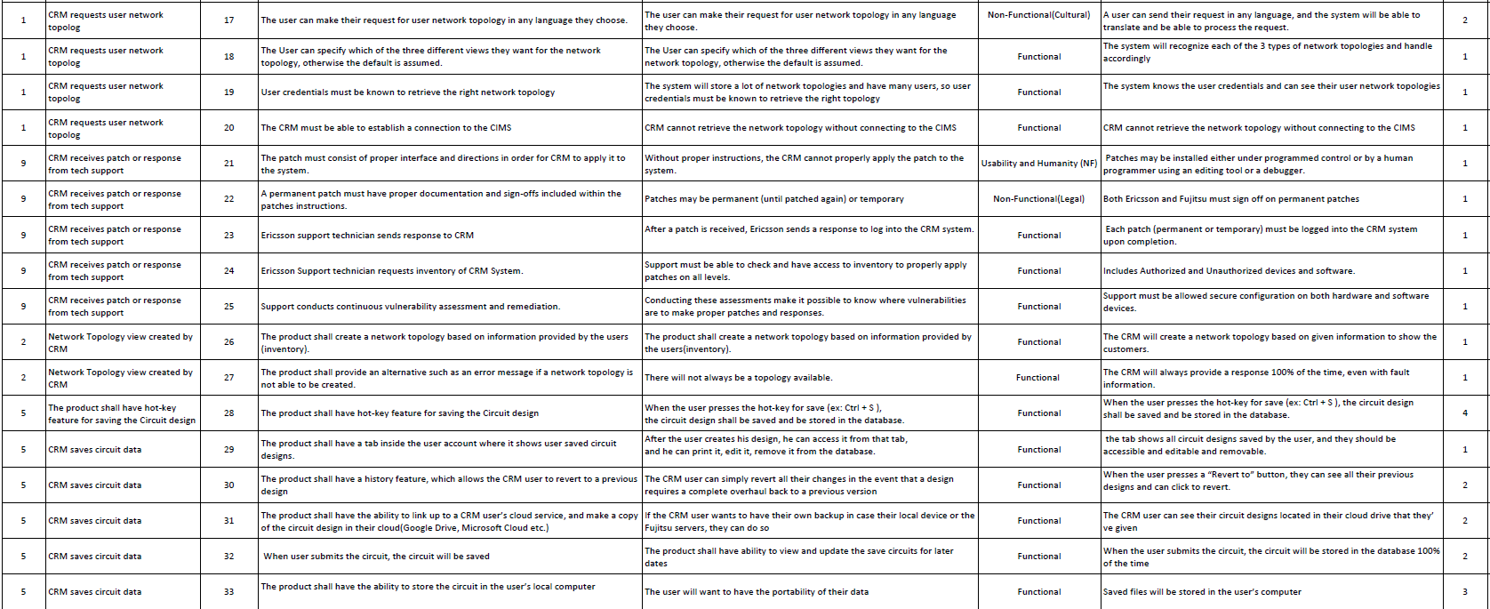
Traceability Matrix - Req to BUC/PUC (continued)

Slide 29
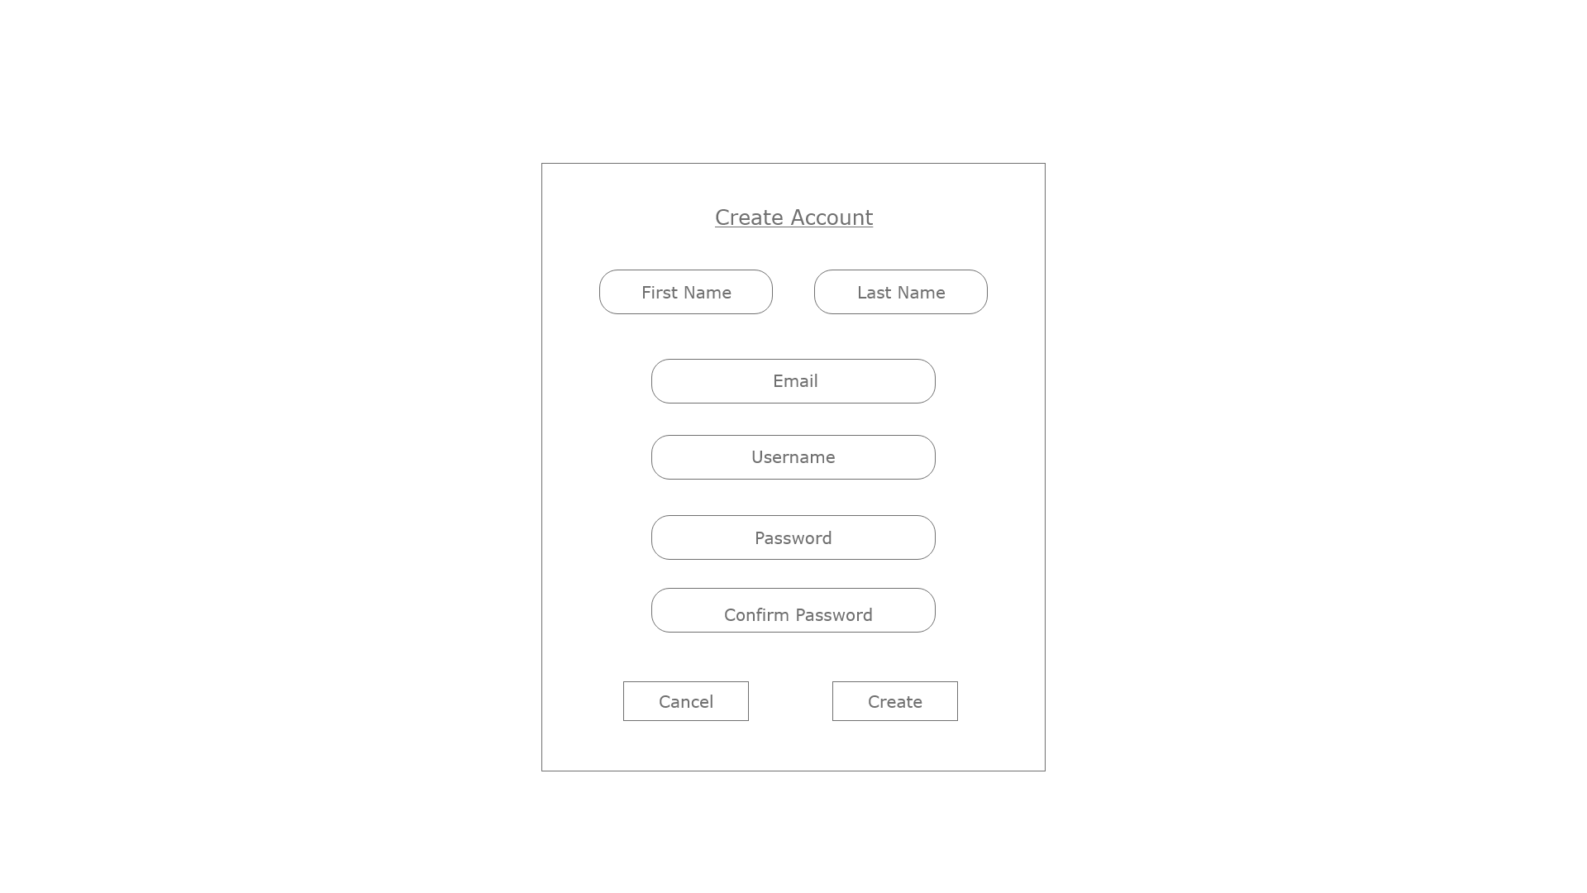
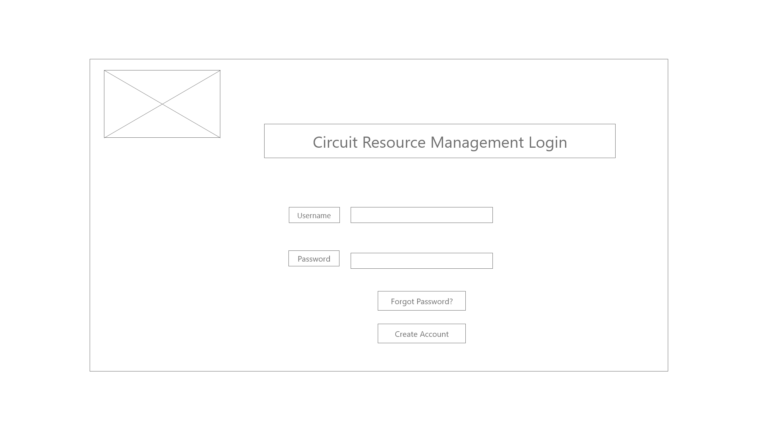
Wireframes

Slide 30
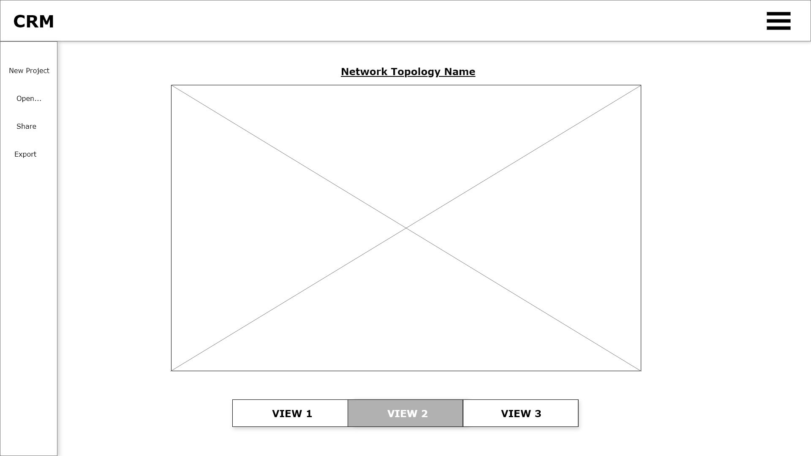
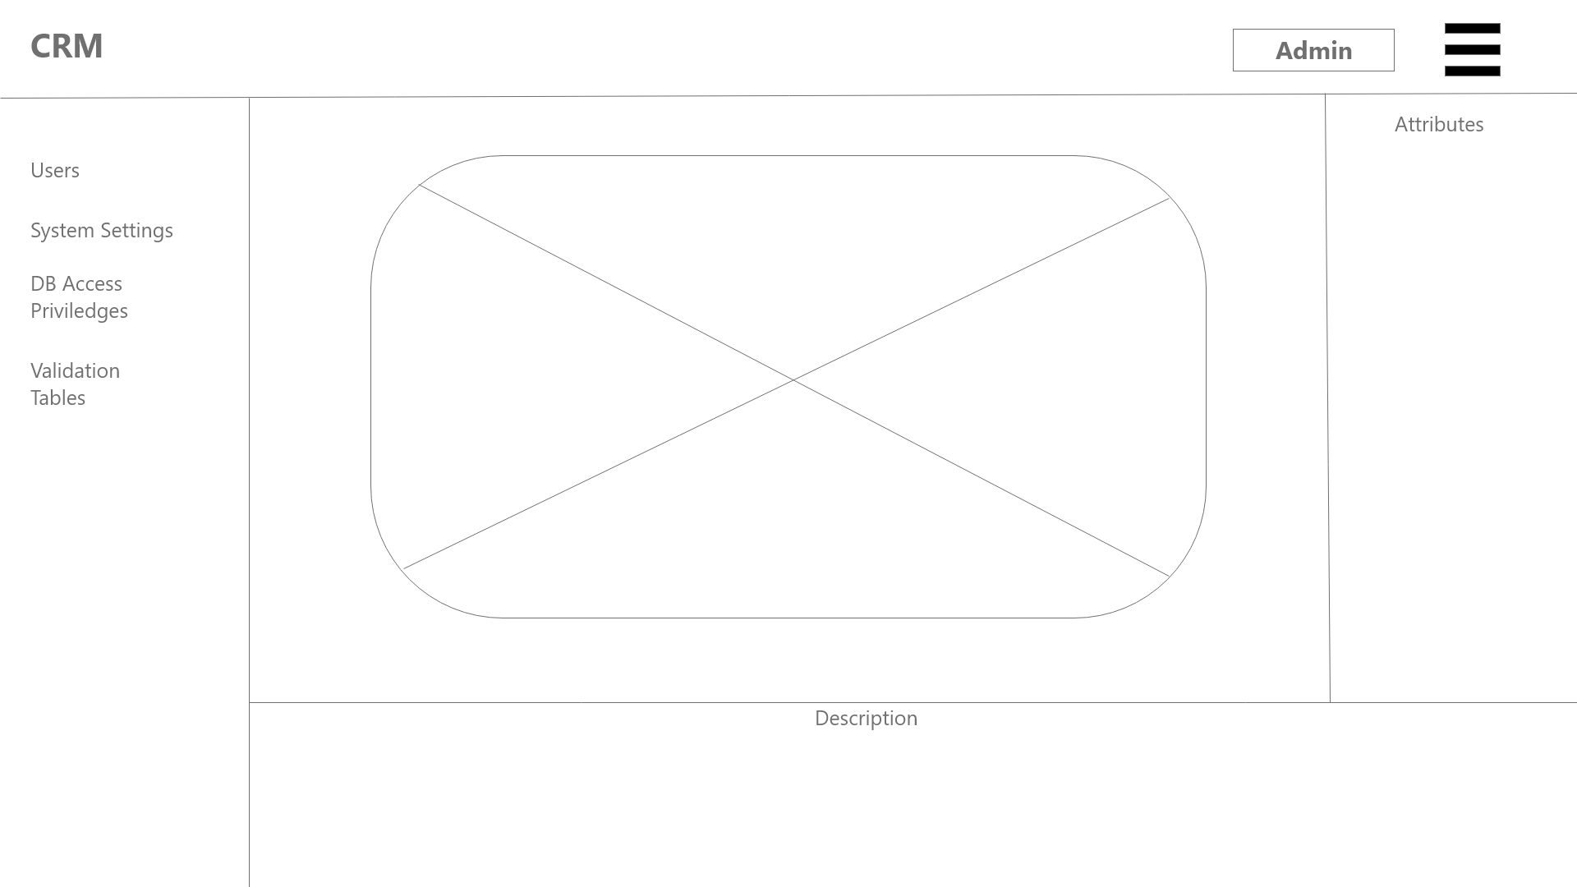
Wireframes

Slide 31
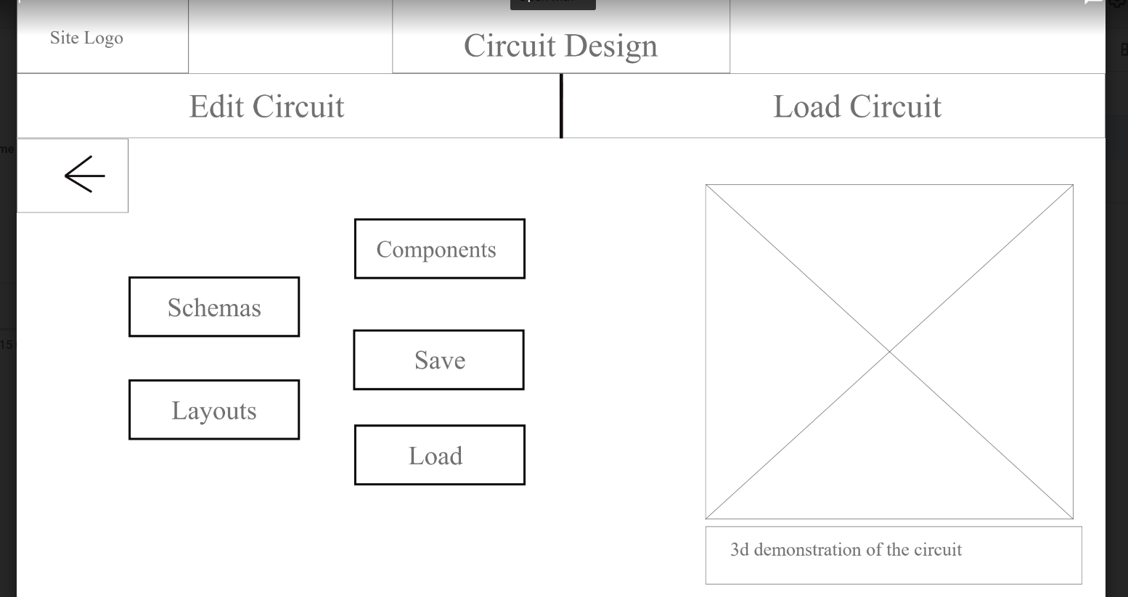
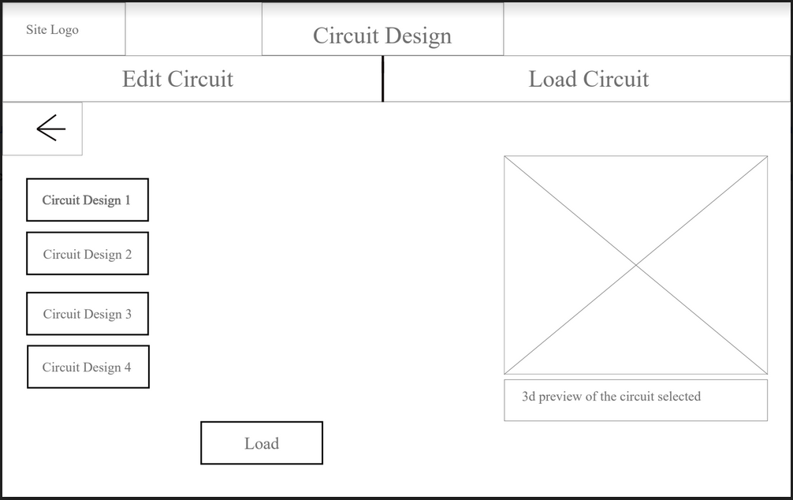
Wireframes

Slide 32
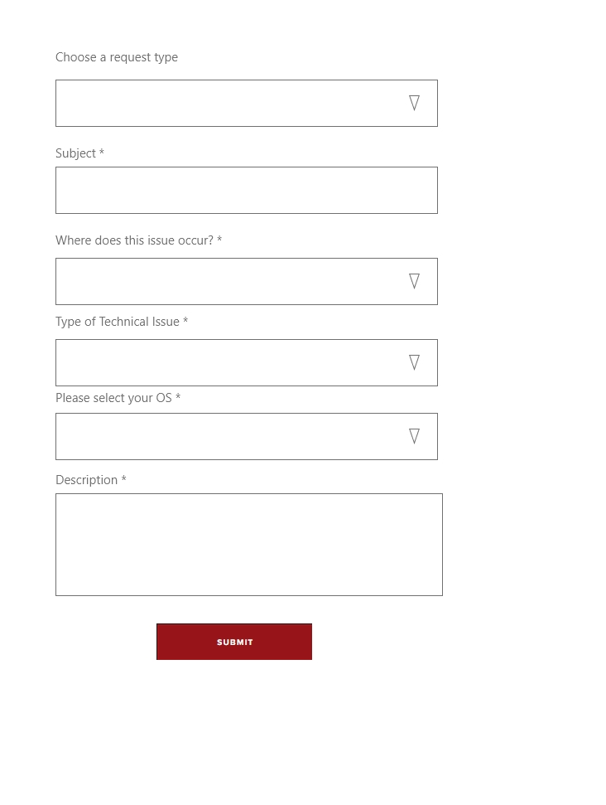
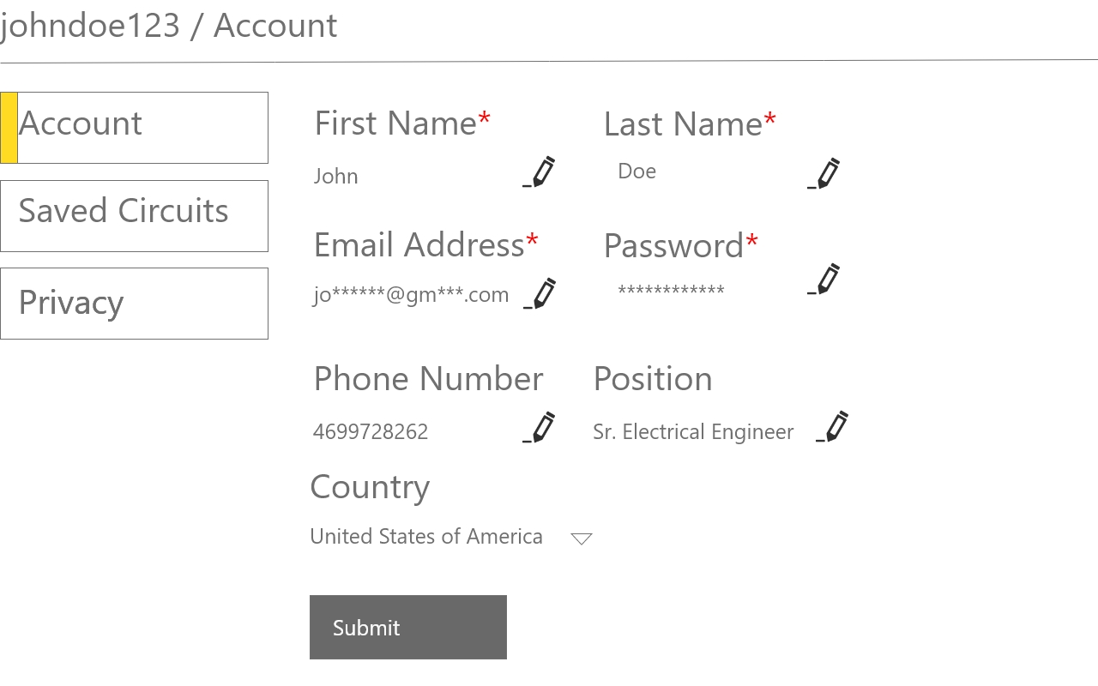
Wireframes

Slide 33
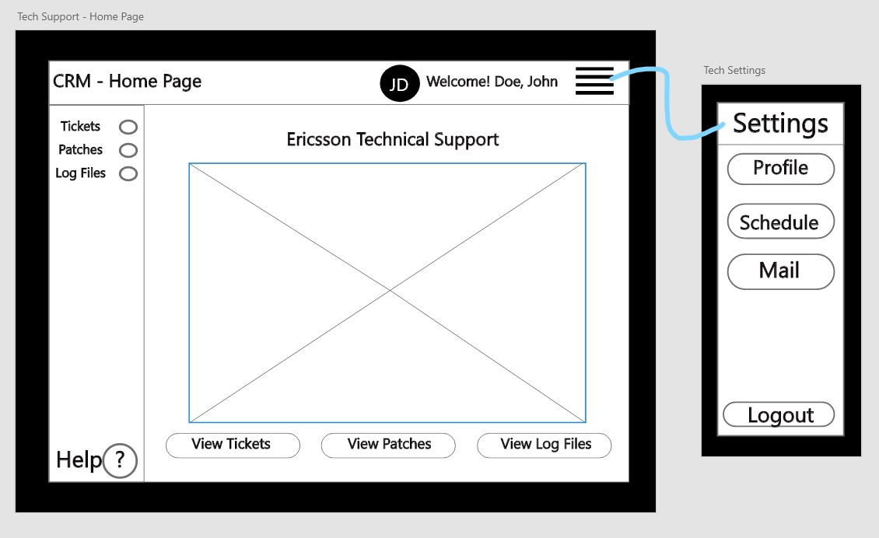
Wireframes

Slide 34
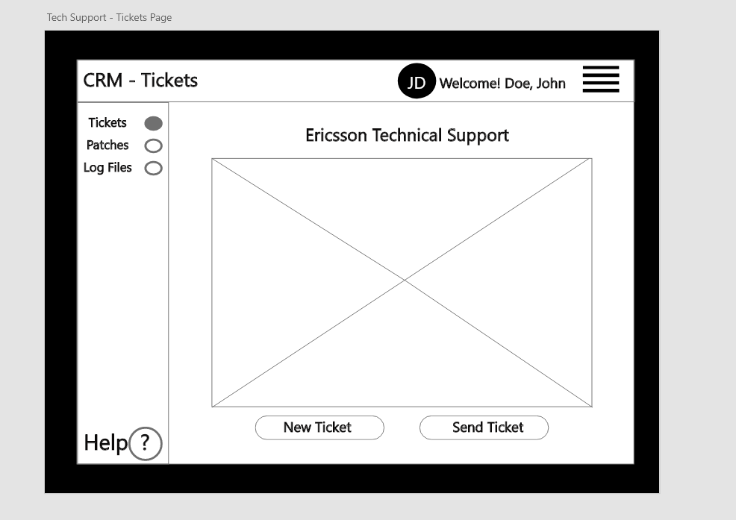
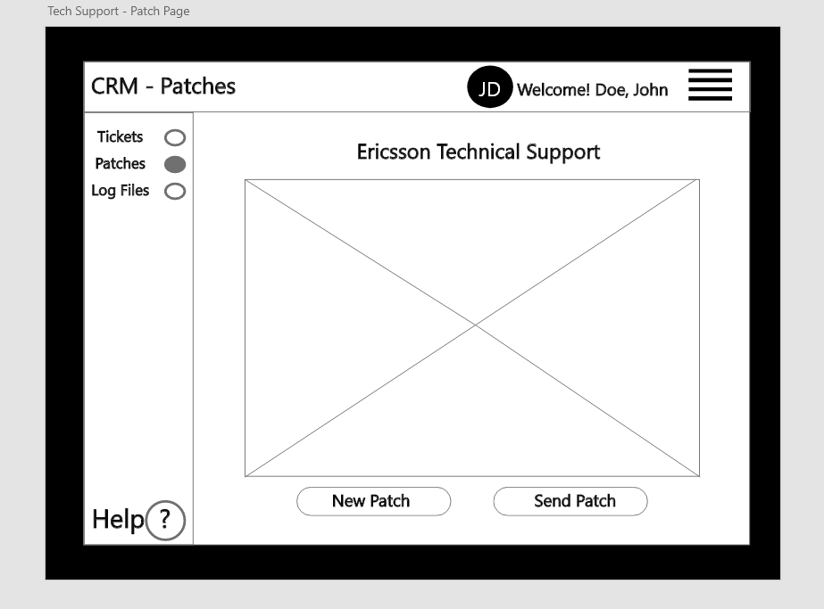
Wireframes

Slide 35
Thank You

